Slide 1
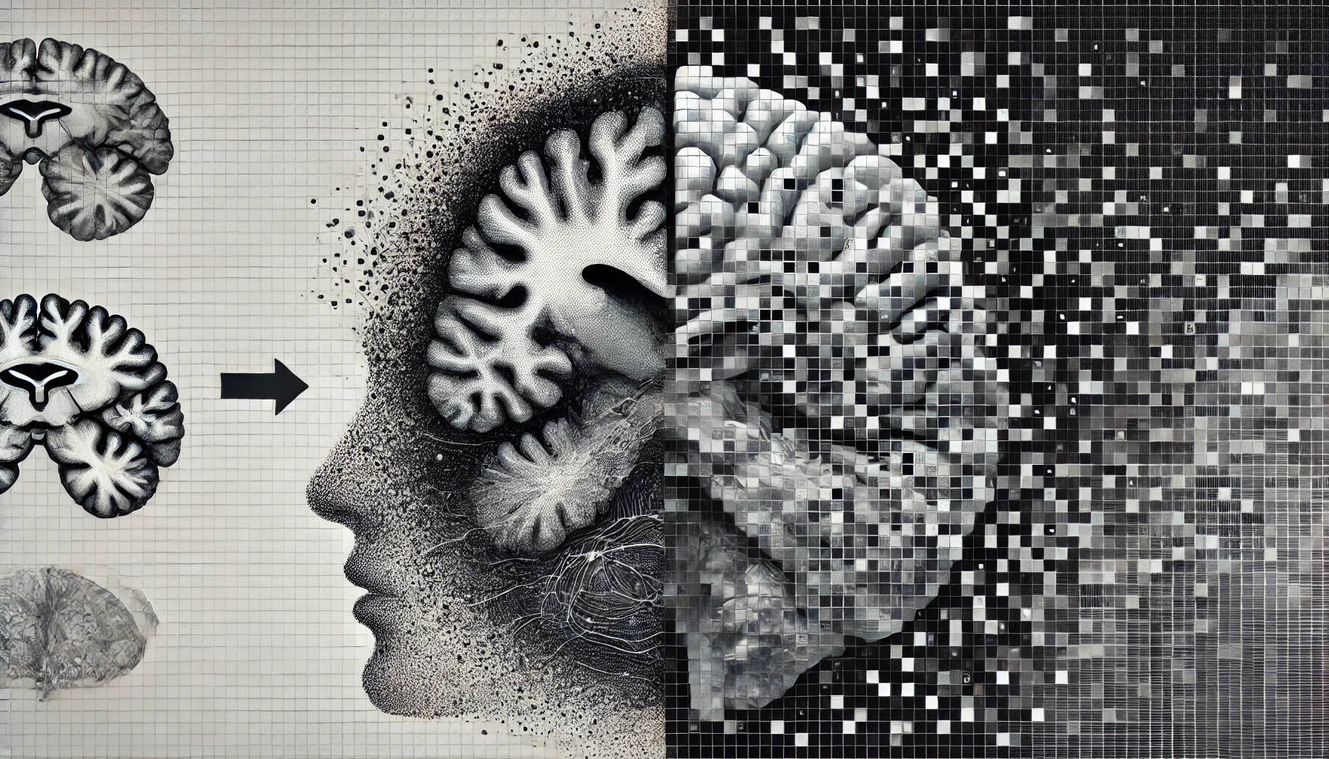


Slide 2
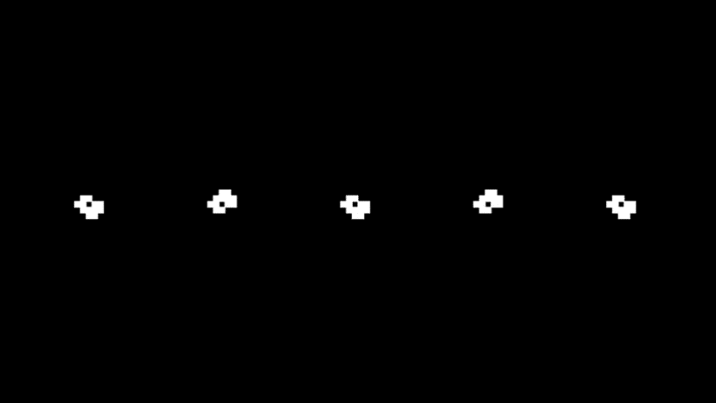

Slide 3
Cellular automata can be trained to recognize patterns, make accurate predictions, and potentially serve as a form of artificial intelligence (AI)

Slide 4
Non-Uniform Elementary Cellular Automata

Slide 5
Non-Uniform Elementary Cellular Automata

Slide 6
Non-Uniform Elementary Cellular Automata

Slide 7
Non-Uniform Elementary Cellular Automata
12
144
72
108
205

Slide 8
Learning Cellular Automata

Slide 9
Learning Cellular Automata

Slide 10
Learning Cellular Automata

Slide 11
Learning Cellular Automata
Input:
12 -> [1 1 0 0]
Problem: number +1
True value:
13: [1 1 0 1]

Slide 12
Learning Cellular Automata
Input:
12 -> [1 1 0 0]
Problem: number +1
True value:
13: [1 1 0 1]

Slide 13
Learning Cellular Automata
Input:
12 -> [1 1 0 0]
Problem: number +1
True value:
13: [1 1 0 1]

Slide 14
Learning Cellular Automata
Input:
12 -> [1 1 0 0]
Problem: number +1
True value:
13: [1 1 0 1]

Slide 15
Learning Cellular Automata
Chromosome: [25,103,86,204,12,165,149,23,205]
Input:
12 -> [1 1 0 0]
Problem: number +1
Time
True value:
13: [1 1 0 1]

Slide 16
Learning Cellular Automata
Chromosome: [25,103,86,204,12,165,149,23,205]
Input:
12 -> [1 1 0 0]
Problem: number +1
Time
Predicted value: True value:
[1 0 1 0] 13: [1 1 0 1]
Distance: 3
Fitness: 1/(3 + 1) = 0.25

Slide 17
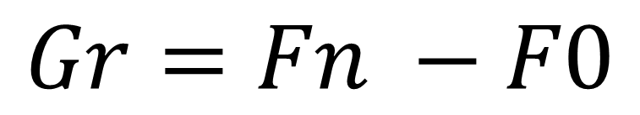
Fitness Growth
$$Gr=Fn −F0$$

Slide 18
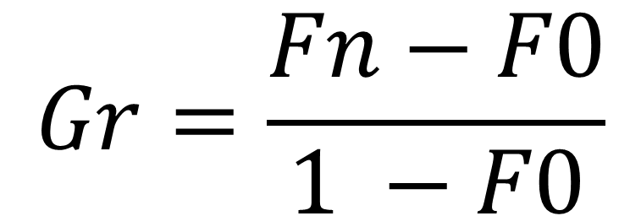
Fitness Growth
$$Gr=\frac{Fn−F0}{1 −F0}$$

Slide 19
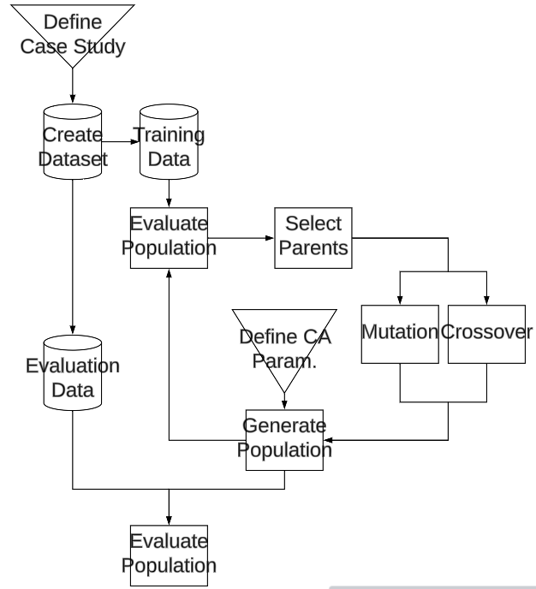
Genetic Algorithms

Slide 20
Genetic Algorithms

Slide 21
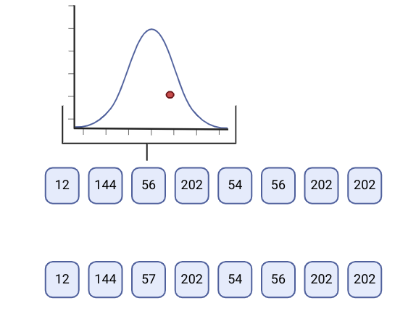
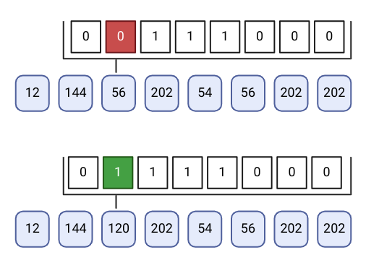
Genetic Algorithms

Slide 22
Genetic Algorithms

Slide 23
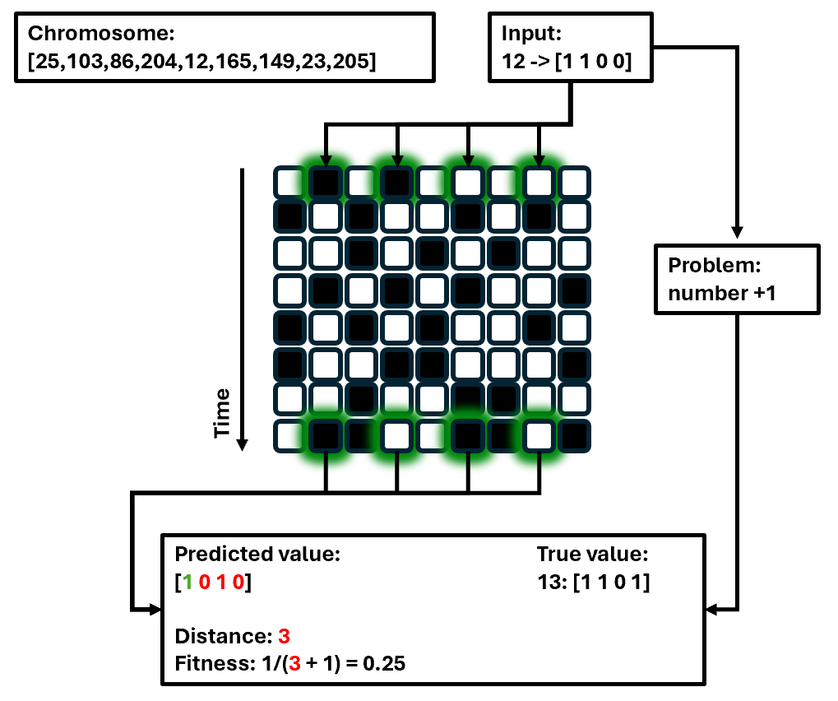
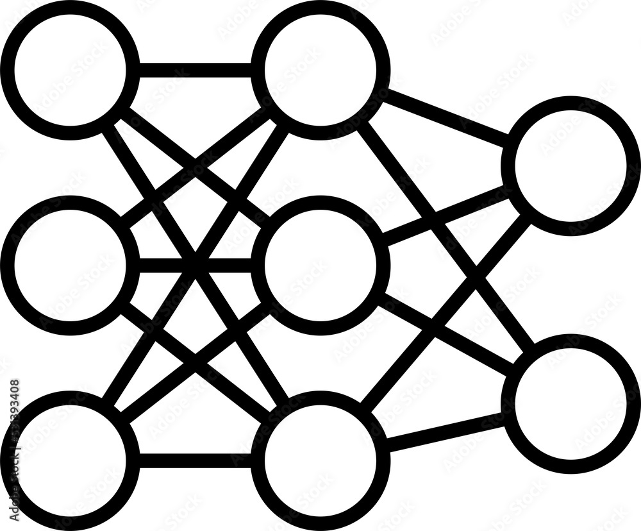
Comparison
VS

Slide 24

Comparison
VS
VS

Slide 25
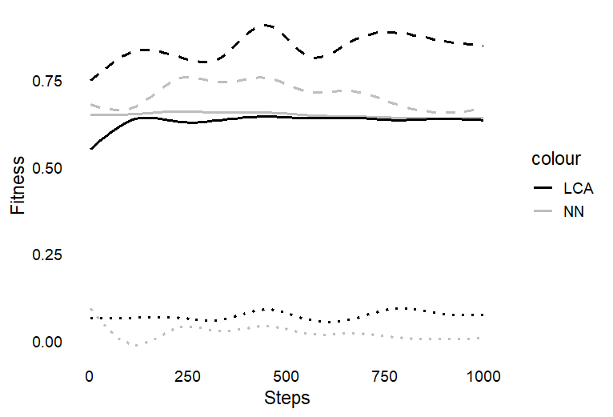
Comparison
VS
VS

Slide 26

Comparison
VS
VS

Slide 27

Comparison
VS
VS

Slide 28
Cellular automata can be trained to recognize patterns, make accurate predictions, and potentially serve as a form of artificial intelligence (AI)

Slide 29
Cellular automata can be trained to recognize patterns, make accurate predictions, and potentially serve as a form of artificial intelligence (AI)
YES*
*with some sidemarks

